Slide 1
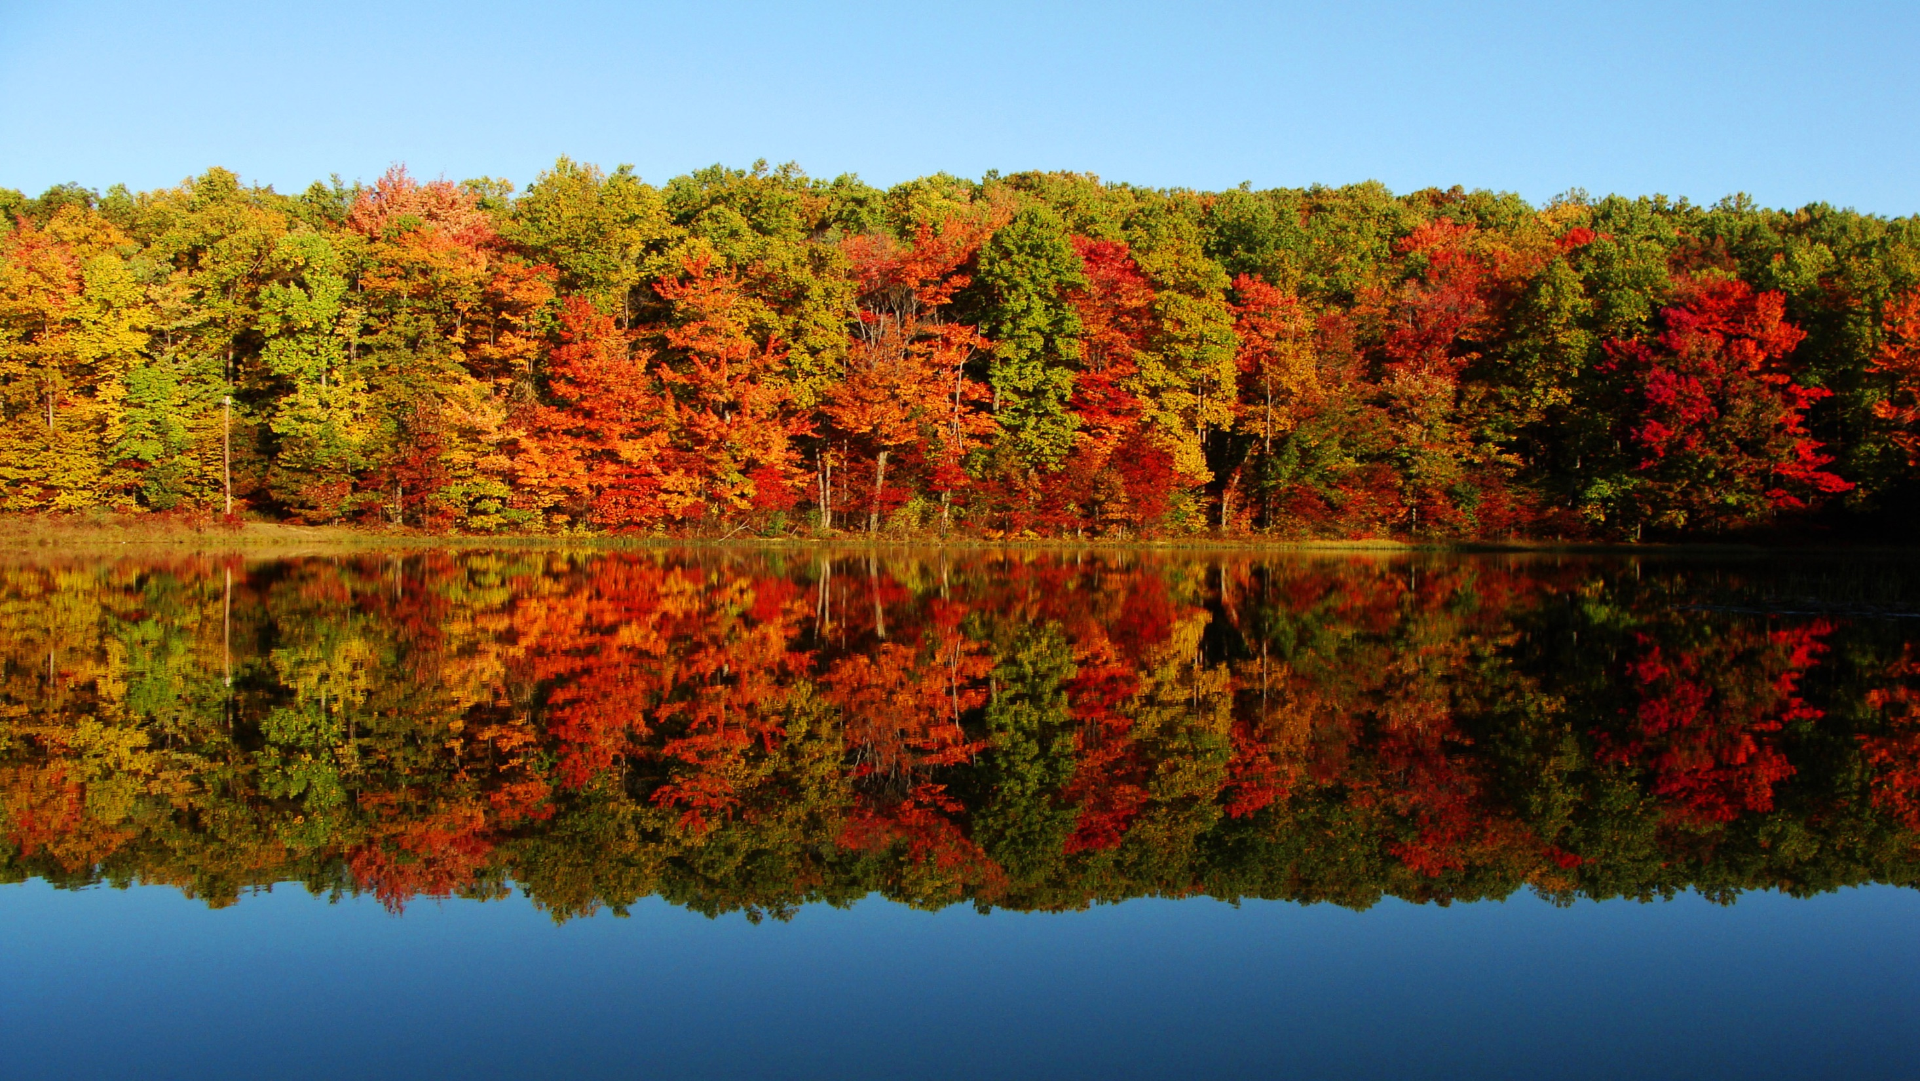
FOREST COVER TYPE
GROUP 1 : DSE_PUNE_SEPT: 2019-2020
Prepared By :
AKASH BRAHMEY
AMAN SHRIVASTAVA
AYUSHI TYAGI
ROSHAN KUMAR
UJJWAL NANDA
VIKASH KUMAR
Mentored by :
MR. MUPPIDI SRIKAR

Slide 2
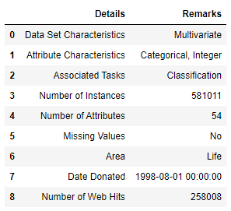
Explanation of the Dataset
Given elevation, hydrology, soil type and Hillshade data can we predict what type of trees would be in a small patch of forest?
Our project attempts to predict the predominant type of tree in sections of wooded area. Understanding forest composition is a valuable aspect of managing the health and vitality of wilderness areas. Classifying cover type can help further research regarding forest fire susceptibility, the spread of the Mountain Pine Beetle infestation and de/reforestation concerns. Forest cover type data is often collected by hand or computed using remote sensing techniques, e.g. satellite imagery. Such processes are both time and resource intensive. In this report, we aim to predict forest cover type using cartographic data and a variety of classification algorithms.

Slide 3
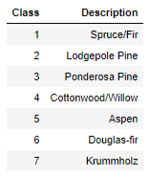
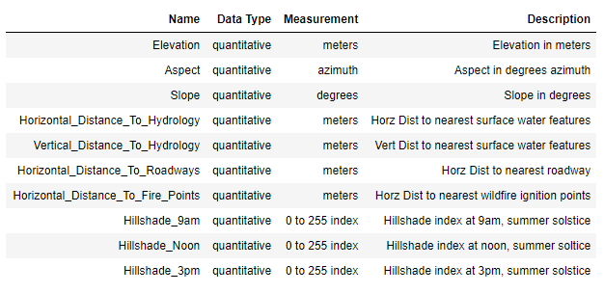
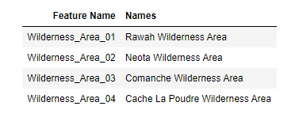
The dataset has 54 features and 1 target variable Cover Type.
From the 54 features, 10 are numerical and 44 are categorical.
From the categorical data 4 are of Wilderness Area and 40 are of Soil Type

Slide 4
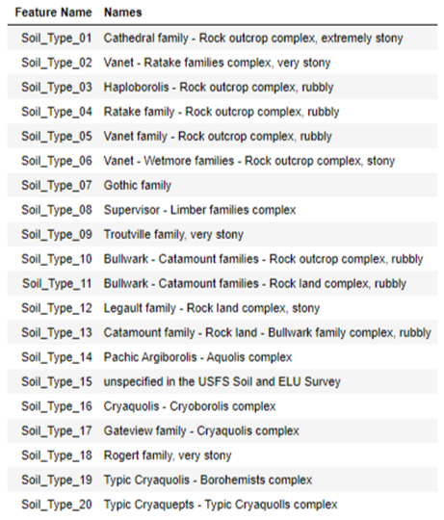
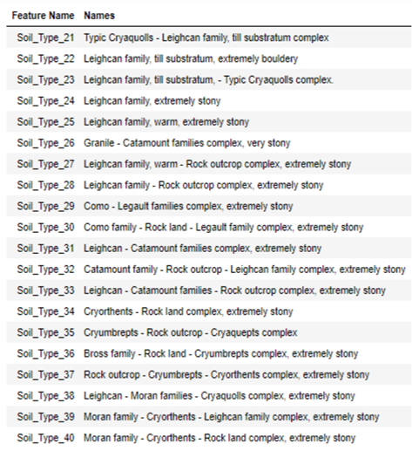

Slide 5
Problem Statement:
The purpose of this Project is to predict forest cover type from cartographic variables only. Given elevation, hydrology, soil type and Hill shade data can we predict what type of trees would be in a small patch of forest? Our project attempts to predict the predominant type of tree in sections of wooded area.
Understanding forest composition is a valuable aspect of managing the health and vitality of wilderness areas. Classifying cover type can help further research regarding forest fire susceptibility, the spread of the Mountain Pine Beetle infestation and de/reforestation concerns.
In this report, we aim to predict forest cover type using cartographic data and a variety of classification algorithms.
Business Uses:
1. Medical purpose to get ideas about type of Flora / Fauna in each Cover type.
2. Furniture factories to get ideas about type of Flora in each Cover type.
3. Government purpose - Areas can be used / Coverage in every Cover type.
4. Suitable Wildlife Sanctuary in every Cover type.
5. Cultivation / Non-Cultivation area in every Cover type.

Slide 6
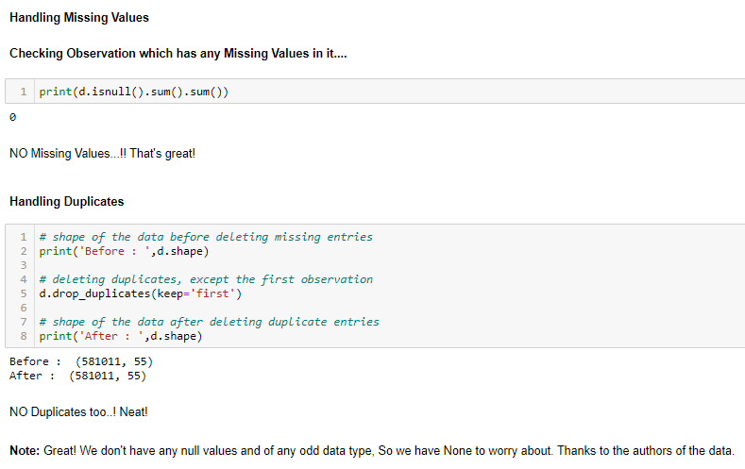
Data Cleaning & Visualisation

Slide 7
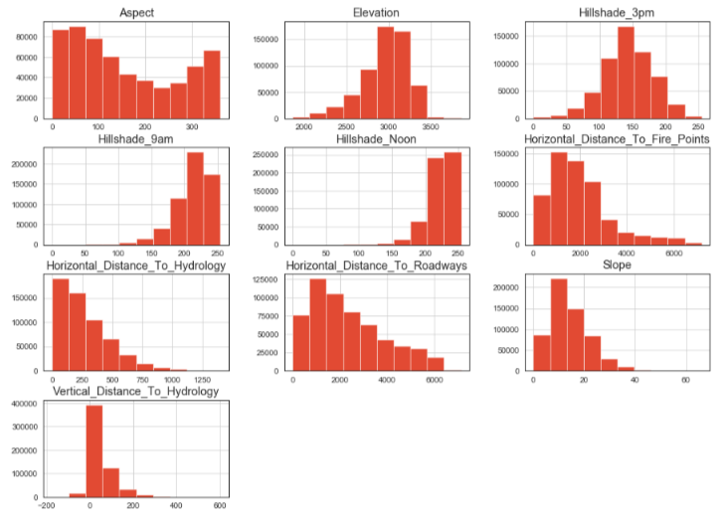
Data Visualization and Analysis
Continuous Data:
Hill shade features varies highly at different interval of time.
Horizontal_Distance_To_Fire_Points has the highest distance from the cover type followed by Horizontal_Distance_To_Roadways feature. Slope having lowest maximum value and also being lowest in range followed by Aspect feature.
The skewness values vary between fairly symmetrical (Hillshade_3pm) to highly skewed (Vertical_Distance_To_Hydrology).

Slide 8
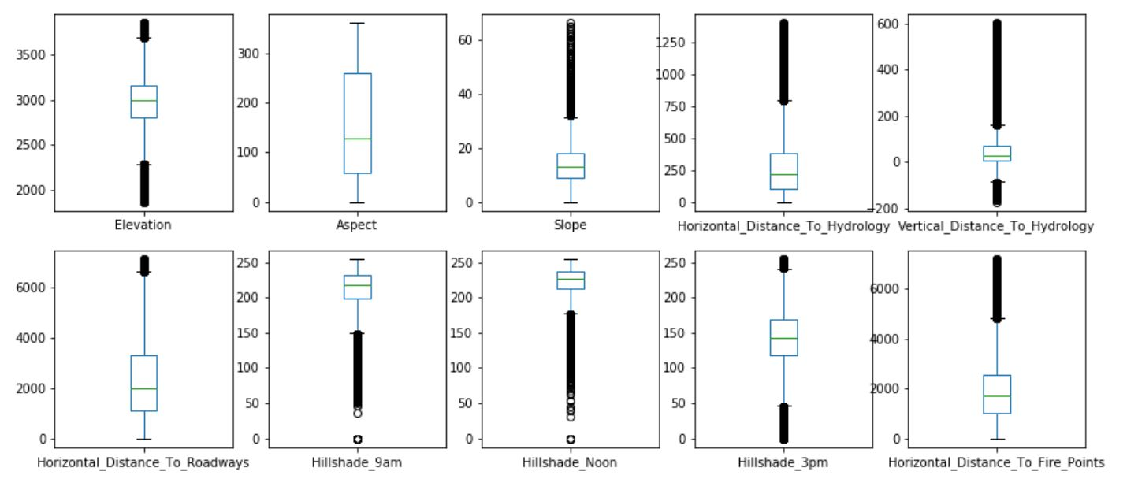
Outliers treatment with z score.
We have data from hills and ground level too, if we remove outliers we will loose much data.
Here we have lost 473106 entries in which we have lost 4 class of target variables.
In the dataset, the features which contains numeric values are of type Discrete Quantitative and has a finite set of values. Discrete data can be both Quantitative and Qualitative. So, treating outliers in this dataset is not possible.

Slide 9
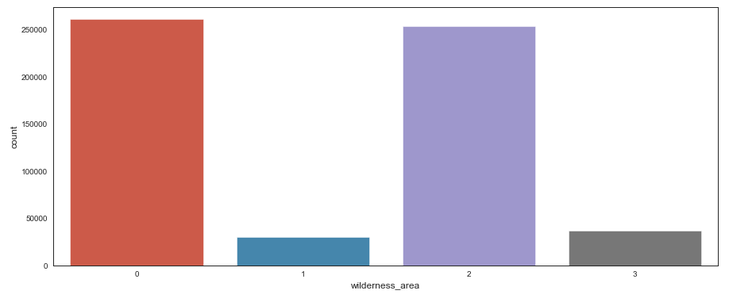
Categorical Data
Wilderness_Area0 and Wilderness_Area2 have maximum observations.
The least amount of observation can be seen in Wilderness_Area1.
Wilderness Area:

Slide 10
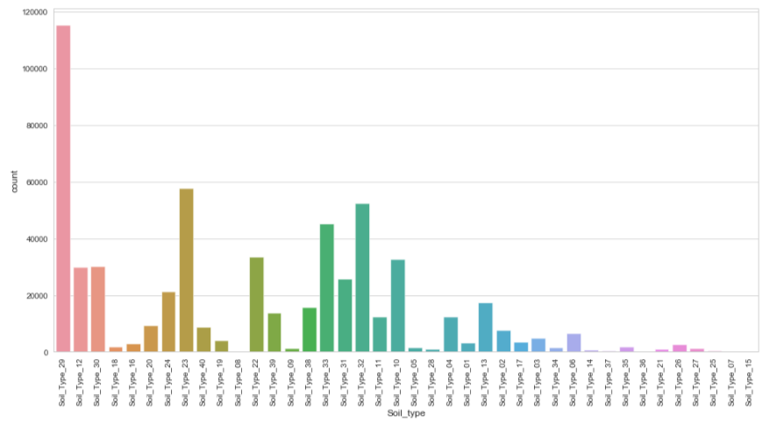
Soil Types:
The most observation is seen from Soil_Type29, it alone has presence in 19.83% of observations in our data. The most positive observations are seen in Soil_Type29 followed by Soil_Type23, Soil_Type32 and Soil_Type33.The least found soil type in the data is Soil_Type15, Soil_Type7 and Soil_Type36.

Slide 11
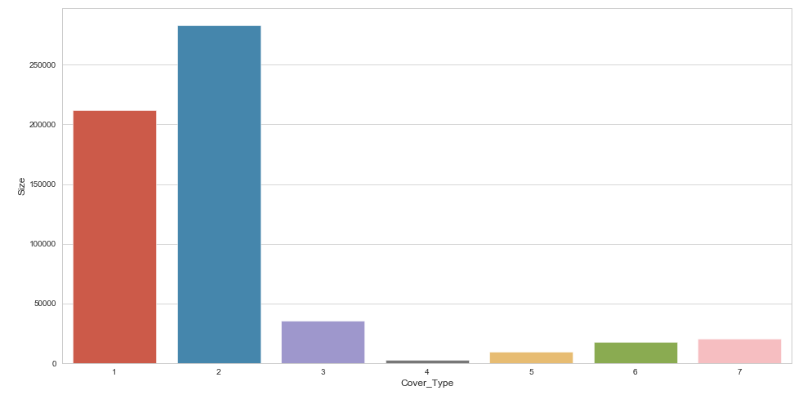
Class Distribution (Target) :
We have uneven samples of forest cover type, where Lodgepole Pine (2) has the highest no. of observation followed by Spruce (1). Only these 2 cover types add up to 495,141 number of observations out of 581,011 total which covers approx. 85.3% of data.

Slide 12
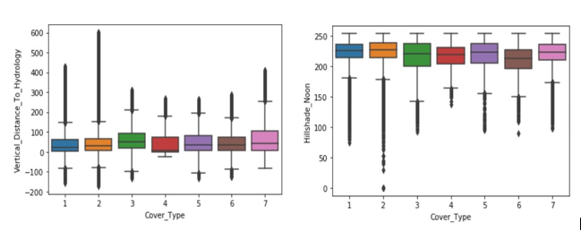
Feature Comparison:
Compare each feature in our data to our target variable, visualizing how much dense and distributed each target variable's class is compared to the feature.
Numerical Features :

Slide 13
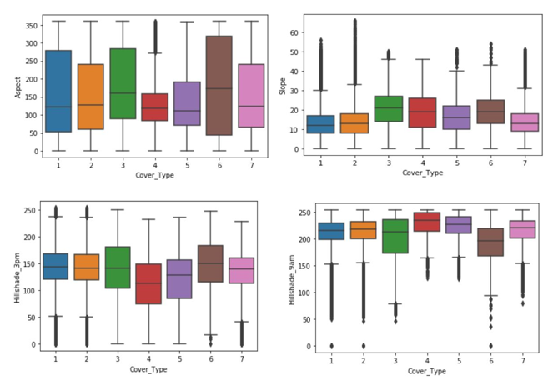

Slide 14
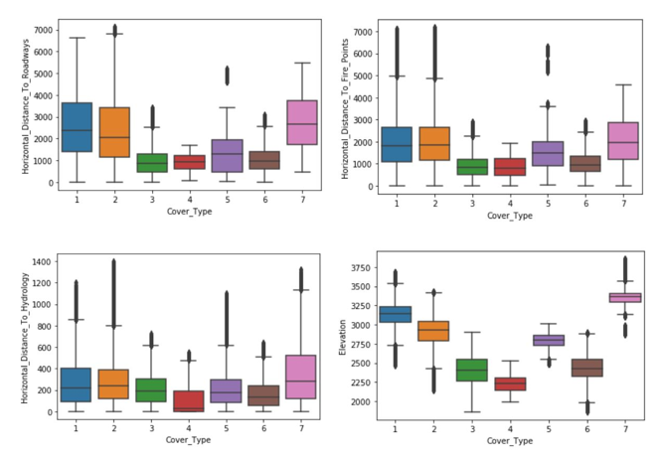

Slide 15
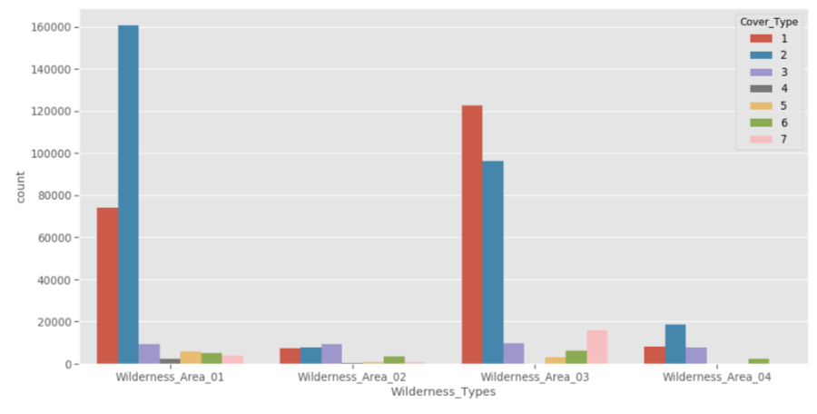
Wilderness Areas :
Most of the cover type that are present in all the wilderness is "Lodgepole pine". Lodgepole pine is a highly adaptable tree that can grow in all sorts of environments, from water-logged bogs to dry sandy soils. Lodgepole pine is one of the first trees to invade after a wildfire. Its cones are protected by a seal of pitch that requires fire or heat to release the seeds.
Cottonwood/Willow are only the most uncommon type of cover type that are found in Cache la Poudre Wilderness Area. Cottonwoods need a location with full sun and lots of moisture. They grow particularly well along lakes and rivers as well as in marshy areas

Slide 16
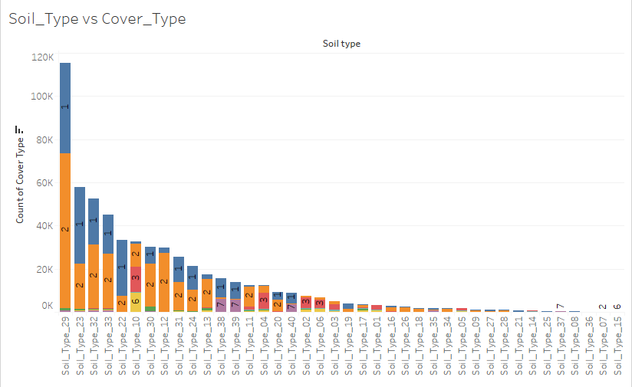
Soil Type :
Como - Legault families complex, extremely stony is highly suitable type of soil for growth of cover type 1 and 2 followed by Leighcan family, till substratum, - Typic Cryaquolls complex then Catamount family - Rock outcrop - Leighcan family complex, extremely stony and then Leighcan - Catamount families - Rock outcrop complex, extremely stony

Slide 17
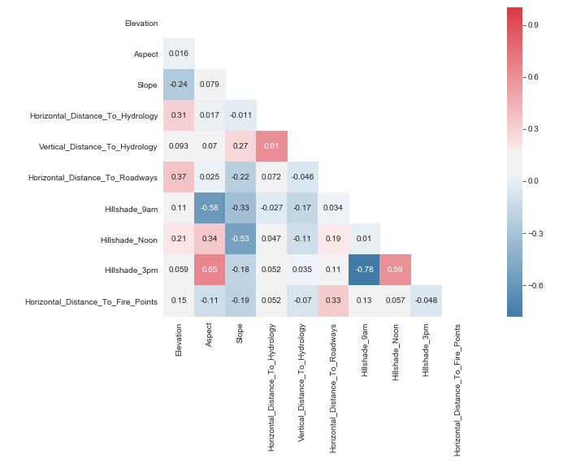
Correlation of continuous features :
Hilshade_3pm is highly negatively correlated with Hillshade_9am.
Horizontal _distance _to_Hydrology is highly positively correlated with Vertical_distance_to_Hydrology.
Aspect & Hillshade _Noon is positively correlated with Hillshade_3pm

Slide 18
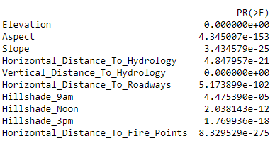
Inferential Statistics
For discrete variables, we will perform Anova test to test feature significance.
Null Hypothesis: The feature is not significant predictor of Target.
Alternate Hypothesis: The feature is significant predictor, i.e., it has high association with Target.
As we have all P-value less than 0.05, all the features are significant.
Dimensionality Reduction
'Elevation', 'Horizontal_Distance_To_Roadways', 'Slope',
'Horizontal_Distance_To_Fire_Points',
'Horizontal_Distance_To_Hydrology',
'Vertical_Distance_To_Hydrology', 'Aspect', 'Hillshade_Noon',
'Hillshade_9am', 'Hillshade_3pm', 'Wilderness_Area_04', 'Soil_Type_12', 'Soil_Type_22', 'Wilderness_Area_03',
'Soil_Type_10', 'Soil_Type_39', 'Soil_Type_38', 'Soil_Type_04',
'Soil_Type_23', 'Wilderness_Area_01', 'Soil_Type_02',
'Soil_Type_40', 'Soil_Type_13', 'Soil_Type_29', 'Soil_Type_30'
We need to see how each feature has an impact on predicting classes, and the best way to do this is by asking the models only. Classifiers like Extra Trees, Random Forest, Gradient Boosting Classifiers and AdaBoost offer an attribute called 'feature_importance_‘.
Out of all features, we would like to go with Top 25 based on score:

Slide 19
MODEL BUILDING :
Define X and Y variable: Now, before applying model, we have prepared the data and segregate the features and the label of the dataset.
Variable X All independent variables necessary to make the prediction.
Variable Y “Cover Type” as Target Variable.
Split the Data into train and test: Splitting the data using sklearn.model_selection (train-test-split): 70% as train data, 30% as test data and random state = 42
Feature Scaling:
One last step before we move to build our model is to scale the features to some specific range. This is called Feature Scaling. Here we used standard scalar to our independent variables.
Algorithms Used:
Since our problem is a classification problem, we will be using the following algorithms in modelling:
• Tree Based Classifiers
- Decision Tree
- Random Forest
• KNN Classifier
• Gradient Boosting
• LGBM Classifier
• Cat Boost

Slide 20
Model performance measures used for evaluating models
Accuracy
Sensitivity
Specificity
Precision
F1 score
ROC
Micro Average
To calculate the micro-F1, we first compute micro-averaged precision and micro-averaged recall over all the samples, and then combine the two. For a multi class classification problem micro-F1 = micro-precision = micro-recall = accuracy = micro-avg.
Model Comparison
Sr.No | Model Name | Training Score | Testing Score | Micro avg
1 | Logistic Regression | 71.91 | 71.79 | 72
2 | Decision Tree | 100 | 92.90 | 93
3 | Random Forest | 100 | 95.35 | 95
4 | LGBM | 86.53 | 85.53 | 86
5 | KNN | 95.05 | 91.91 | 92
8 | Cat Boost | 88.99 | 88.17 | 88

Slide 21
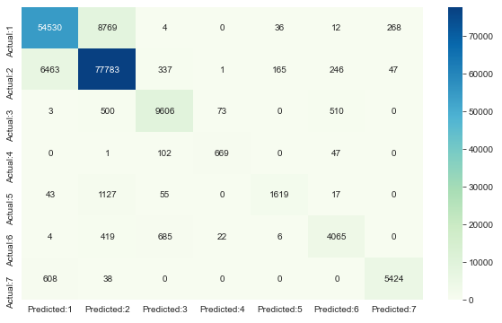
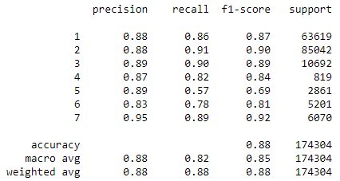
Cat Boost Classifier : Training Score: 88.99 & Testing Score: 88.17
Classification Report (Cat Boost):
Confusion Matrix(Cat Boost):

Slide 22
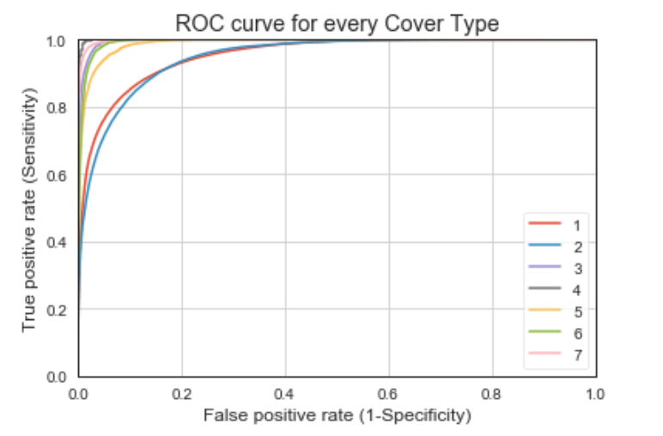
ROC Curve:
ROC_AUC_SCORE: 86.56
Area Under The Curve(AUC):The area under the ROC curve quantifies model classification accuracy the higher the area, the greater the disparity between true and false positives, and the stronger the model in classifying members of the training dataset.
An area of 0.5 corresponds to a model that performs no better than random classification and a good classifier stays as far away from that as possible. An area of 1 is ideal. The closer the AUC to 1 the better.
Cohen_Kappa_Score: 76.03
Cross Val Score: 75.6

Slide 23
Conclusions
Since it is multiclass classification problem we considered micro average as metric of evaluation. From the models built and the tests performed, Tuned Cat Boost is the best method to predict the Cover type for forest from a Machine learning perspective.
When using Cat Boost Classifier we are getting the best fit among all our models. This cat boost algorithm works best when the data is having more than 80 percent of categorical features. It also reduces the need for extensive hyper parameter tuning and there is very low chance of over fitting.

Slide 24
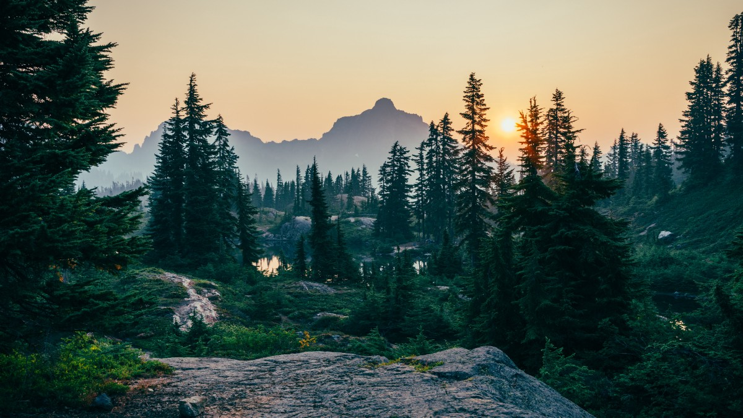
THANK YOU

